Slide 1
DOM Events
Mr Mack 2022

Slide 2
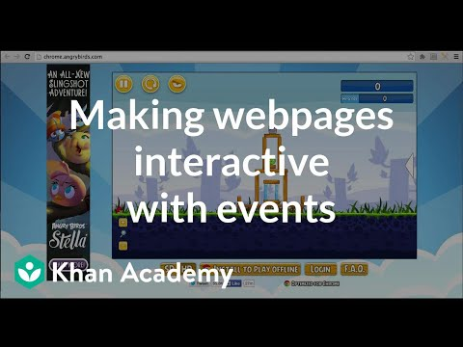
Making webpages interactive with events

Slide 3
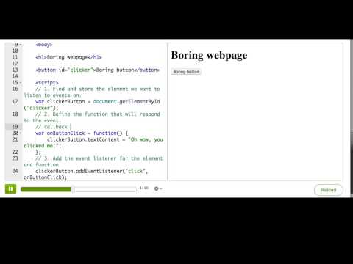
Adding an event listener

Slide 4
Practice: Cat Clicker
In this challenge, you'll make it so the user (you!) can pet the cat and see it meow. In this first step, find the cat image element and store it in a variable.
Store the element

Slide 5

Practice: Cat Clicker
Now, define a callback function that changes the inner text of the 'cat-chat' div to say 'Meow', or whatever you think cats say when you pet them.
Define the callback function

Slide 6

Practice: Cat Clicker
Finally, assign the callback function as the event listener for the 'click' event for the cat image.
Attach the listener

Slide 7
Practice: Cat Clicker
Make sure you click the cat to check that it works! Cats love being petted. :)
Click the cat

Slide 8
DOM event types
The browser triggers many events. A full list is available in MDN, but here are some of the most common event types and event names:
mouse events (MouseEvent): mousedown, mouseup, click, dblclick, mousemove, mouseover, mousewheel, mouseout, contextmenu
touch events (TouchEvent): touchstart, touchmove, touchend, touchcancel
keyboard events (KeyboardEvent): keydown, keypress, keyup
form events: focus, blur, change, submit
window events: scroll, resize, hashchange, load, unload
Notes:
You might be wondering when to use touch events versus mouse events, since they're so similar.
Touch events are only triggered on touch-enabled devices like smartphones and touch-screen laptops. Mouse events like click and mousemove are triggered on the majority of browsers and devices. However, in most smartphones, the mouseover event isn't triggered at all, because they can't detect a finger hovering over the phone. Some smartphones are adding sensors for that though, so more smartphones will detect mouseover in the future.
In most cases, you'll want to listen to mouse events instead of touch events, because those are the most universal.

Slide 9
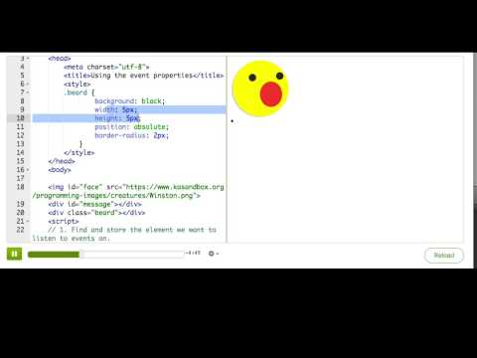
Using the event properties

Slide 10
Practice: Cat-stache
This webpage puts a mustache image on top of a cat image when the user clicks it, but it always lands up at 100 pixels down and 100 pixels from the left. Change the callback function to use the event properties to position the mustache according to where the user clicks.
Position the mustache

Slide 11
Practice: Cat-stache
Make sure you click around to see how the mustache looks. You might want to add/subtract a little from the event properties, since the image is being positioned according to its left corner, not center.
Click the cat

Slide 12
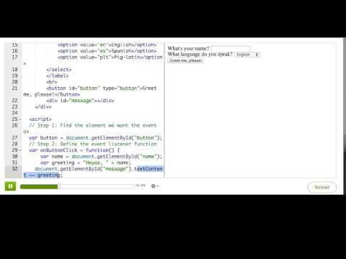
Processing forms with events

Slide 13
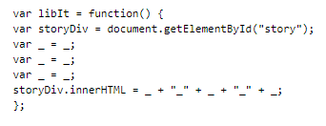
Practice: Mad Libs
This webpage has the start of a Mad Libs game. If you've never played it, that's a game where you fill in a bunch of blanks of different word types, and then a story is generated based on those words, and sometimes the story is surprisingly funny.
In this step, you're going to finish the game logic in the event listener: find the value of each of the word inputs, and then write out a story that uses each of the values. Make sure you check the console for errors when you play the game
Tell the story

Slide 14
Practice: Mad Libs
Enter some values in, click the button, and read the story that comes out.
Once you complete this challenge, you can keep going by making a spin-off, adding more fields and maybe even pictures based on what they type.
Play the game

Slide 15
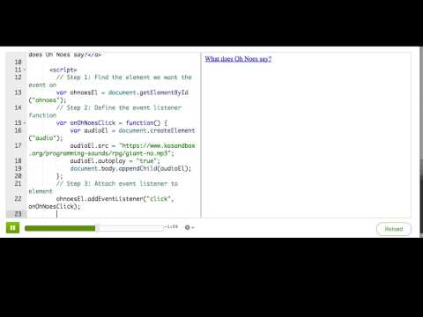
Preventing default behavior of events

Slide 16
Summary: DOM events

Slide 17
Adding event listeners
To make sure that the browser calls a particular function when an event happens on an element, you must use document.addEventListener:
var buttonEl = document.getElementById("clicker");
var onButtonClick = function() {
console.log("Oh golly gosh, you clicked me");
};
buttonEl.addEventListener("click", onButtonClick);
You can pass many valid strings as the first argument, see the event types article.

Slide 18
Adding event listeners
If you want information about the event that happened, you can look at the event object that the browser passes to your callback function:
var faceEl = document.getElementById("face");
var onFaceClick = function(e) {
console.log("You clicked " + e.clientX + " , " + e.clientY);
};
faceEl.addEventListener("click", onFaceClick);
There are many properties on the event object, you can see a full list here.
If you are overriding click behavior on a link or submit behavior on a form, you may want to call event.preventDefault() to prevent the browser's default behavior.

Slide 19
Removing event listeners
If you no longer need a particular event listener, you can remove it using removeEventListener:
var faceEl = document.getElementById("face");
var onFaceClick = function(e) {
console.log("You clicked " + e.clientX + " , " + e.clientY);
};
faceEl.addEventListener("click", onFaceClick);
// later...
faceEl.removeEventListener("click", onFaceClick);

